Slide 1
Machine Learning Techniques for the Detection of Powdery Mildew in Vineyards
Michael Acosta
Notes:
Ok, let’s get started. Thank you for being here today for my thesis defense. I am excited to present my work titled: “Machine Learning Techniques for the Detection of Powdery Mildew in Vineyards”. Before I start, I want to thank Dr. Raheja and Dr. Bhandari for letting me join this project and work with great people and technology. The chance to work on a real problem and offer a solution that can boost agricultural output has meant a lot to me. I’m really excited to share this work with you. It’s taken a lot of work to get here from many people: Tristan and the flight team, as well as Cristobal and the plant science team as well as everyone in the computer science department. So let’s get into it!

Slide 2
Institution: California State Polytechnic University, Pomona
Date: Fall 2024
Committee Members: Dr. Amar Raheja, Dr. Subodh Bhandari, Dr. Yu Sun

Slide 3
Presentation Outline
Introduction
Methodology
Results
Conclusion

Slide 4
Introduction

Slide 5
Literature Survey Highlights
The survey breaks down as follows:
Powdery Mildew (PM)
Current Best Practices
Handheld Proximal Sensors
Drones and UAVs
Security Challenges

Slide 6
Powdery Mildew (PM)
PM is caused by the Erysiphe necator fungus [1], affecting 7,600 plant species [2]; viticulture uses 19.5 kg/ha of fungicides yearly, contributing to pesticide-resistant strains [3].
PM thrives in mild temperatures (ideal at 77°F)[2] and is challenging to detect early, especially under shaded canopies where growth is fostered.
PM infection reduces fruit yield, causes berry splitting, and affects photosynthesis, sugar content, juice color, and wine quality [4].
Current practices include disease-resistant grape species and pesticide use, but widespread application increases costs, resistance, and pollution [5].

Slide 7
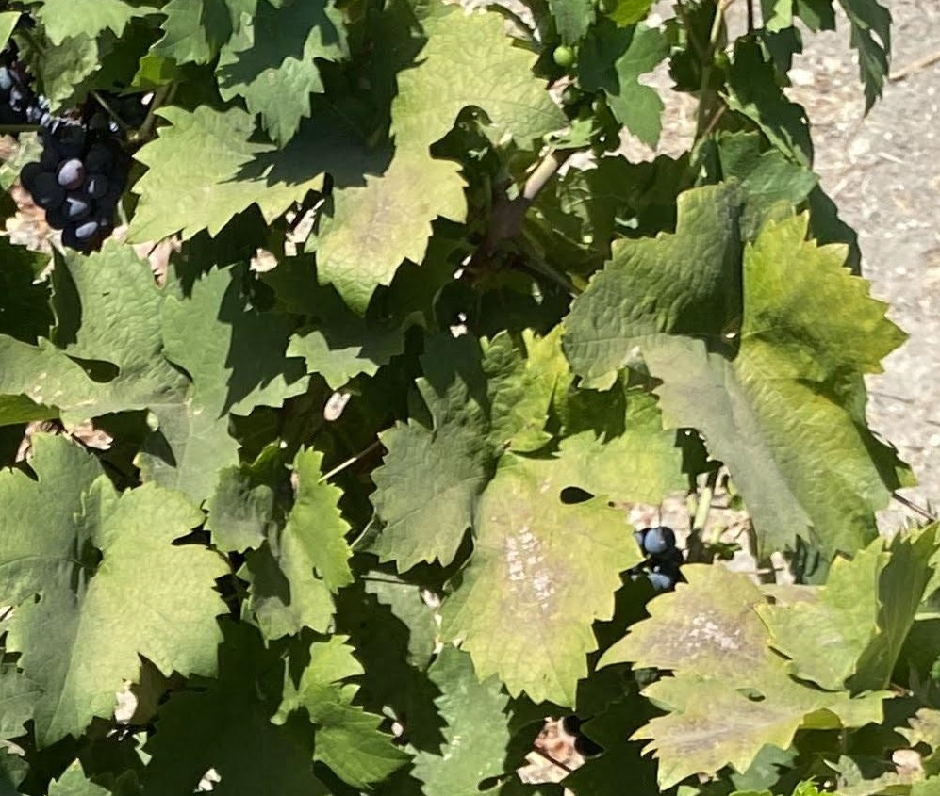
Notes:
This image was taken up close with my cell phone camera. It shows a range of powdery mildew, starting with a white powder on the right hand side. And eventually it will get severe and kill the leaf causing damage shown in the middle of the image.

Slide 8
Current Best Practices
Traditional on-site visits and visual inspections are the primary methods for identifying pests in crops and vineyards but are labor-intensive and prone to error.
Manual inspections face challenges such as bias, optical illusions, high labor costs, and inaccuracies leading to financial loss [6].
Handheld sensors and lab equipment provide accurate data but increase time and cost.
Precision agriculture offers scalable solutions to reduce labor reliance and enhance monitoring, addressing food production challenges.

Slide 9
Current Best Practices
At least 10% of global food production is lost annually to plant diseases, worsening food insecurity for over 800 million people [7].
Thermal imaging has been used to detect early-stage PM in crops like wheat [2].
In grape cultivation, moisture management is critical to prevent mildew caused by environmental factors like temperature and humidity.
Vineyard inspections and fungicides are employed to address moisture-induced issues.
Growers use pest thresholds to guide intervention decisions and maintain grape quality.

Slide 10
Handheld Proximal Sensors
Handheld farming devices, such as Chlorophyll Meters, NDVI Sensors, and Water Potential Meters, collect data to validate plant health.
Some devices are field-usable, while others require lab testing, increasing cost and time.
The SPAD 502 Chlorophyll Meter clamps onto leaves and measures chlorophyll nondestructively at two wavelengths.
Chlorophyll measurements from the SPAD 502 allow quick nitrogen content calculation [8], speeding up nitrogen level assessment compared to full-plant testing.

Slide 11
Drones and UAVs
Drones offer scalability, completing tasks in a fraction of the time compared to handheld devices, with the added benefit of consistent data collection.
Weekly UAV flyovers establish a field baseline, enabling efficient progress tracking and predicting PM severity and grain yield.
Satellite imagery provides structured data for broader applications like urban planning and climate change [9].

Slide 12
Security Challenges
Precision agriculture faces vulnerabilities, including pranks and state-sponsored attacks, with an estimated $10 million in economic losses globally [10].
Potential attack types include reverse engineering, MITM, spoofing, DoS, false data injection, and RF jamming [10].
Data poisoning is a risk with computer vision and ML; federated learning can secure models by training them locally and updating only with consensus, while mitigating risks [10].

Slide 13
Introduction
AI and ML in precision agriculture identify crops, weeds, and diseases via drones.
Powdery mildew (PM) is a major challenge for vineyards.
Early PM detection is critical; visible symptoms appear too late for action.
Hyperspectral imaging aids detection but is computationally expensive.

Slide 14
Introduction
YOLO model proposed for PM detection using conventional images.
Model trained on annotated cell phone and drone images.
Provides actionable insights and early warning for PM levels.
Red Zinfandel grapes at Cal Poly Pomona are highly susceptible to PM.
Harvest season for Red Zinfandel is typically October.

Slide 15
Test Plot
Vineyard near Cal Poly Pomona farm store is used as the test plot
The targeted section consists of 14 rows of vines

Slide 16
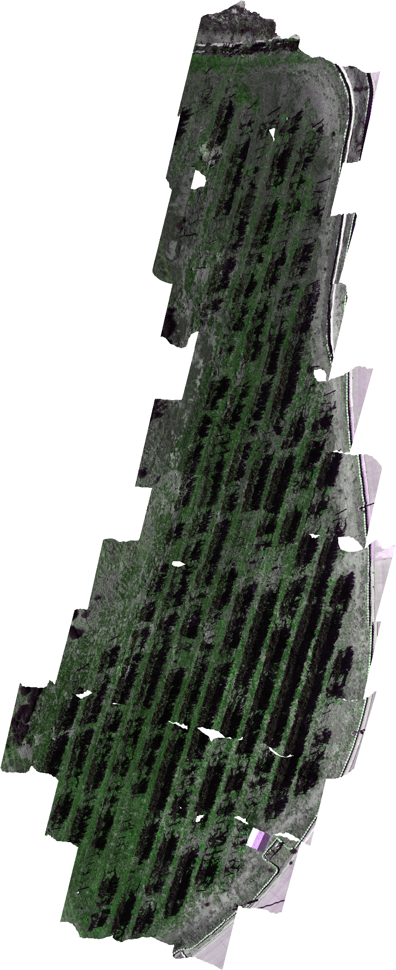
Notes:
This is a look at the entire field. It is a large area with a lot of vines. However, the drone flyover only takes about 10 minutes which shows how effective it is.

Slide 17
2. Methodology

Slide 18
Research Goals
Collect and process imagery of vineyards.
Train ML models to detect PM.
Evaluate and compare the model’s predictions.

Slide 19
Methodology
Data Collection and Processing
ML Training
Evaluate Model Performance

Slide 20
Handheld Camera Collection
Images were captured at Cal Poly Pomona vineyard using an iPhone 11 camera from about 2.5 meters height (Handheld Camera Trained).
Image resolution was 3024 by 4032 pixels, taken close to the drone flight on each collection day.
Data collection occurred on Tuesdays around noon, from September to November 2024, at the end of the grape growth cycle.
Notes:
Using an extendable selfie stick for phone image capturing would give better, more consistent results.

Slide 21
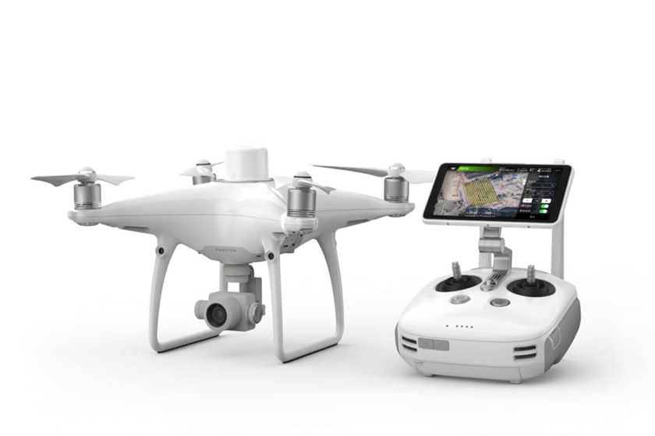
Drone Collection
The DJI Phantom 4 RTK has a 1-inch, 20-megapixel CMOS sensor, a gimbal with stabilization on tilt, roll, and yaw axes, and a max speed of 36 mph.
It achieves a ground sample distance of 2.74 cm at 100 meters flight altitude, and the lens specs include FOV 84°, 8.8 mm/24 mm (35 mm equivalent), and an f/2.8 - f/11 aperture with auto focus from 1m to infinity.
Imagery was collected at 5 meters altitude (lowest to avoid collisions with vines), saved with GPS data, under clear skies and low wind, based on preset flight waypoints, on Tuesdays from September to November 2024.

Slide 22
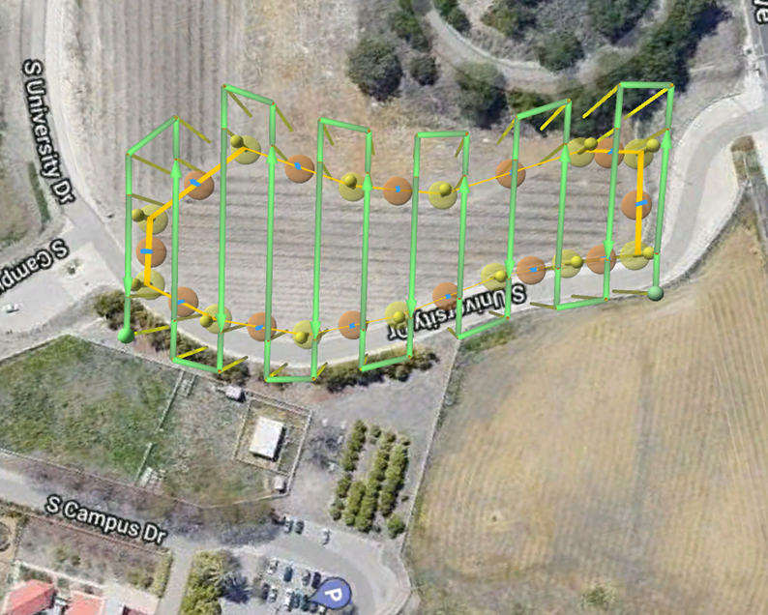
Data Collection - Drone
Notes:
This is the path that the drone takes while flying. The images are not too large from the Phantom 4 in terms of ground area. The entire vineyard is captured in about 250 individual images. We now have RGB imagery captured at 5 meters and 7 meters from September 3rd to December 3rd 2024 that is ready to annotate (as of today, 12/17/24).

Slide 23
Pre-processing
After the images are collected, manual pre-processing is necessary in order to select quality images.
Each image should have a vine where a healthy or diseased detection is possible.
Images should avoid being all dirt or miscellaneous objects.
Both the classes should be balanced.

Slide 24
ML Training - YOLO
The models will be trained using two methods.
For both methods, the images and annotations will create a custom dataset that will be fed into the YOLO model. Each row of a text file represents one bounding box.
Two YOLO models will be used in each combination of testing and training data: v8n and v10n. The n models prioritize lightweight, fast performance.

Slide 25
CVAT
Computer Vision Annotation Tool
Online annotation tool that generates annotations in a variety of formats.

Slide 26
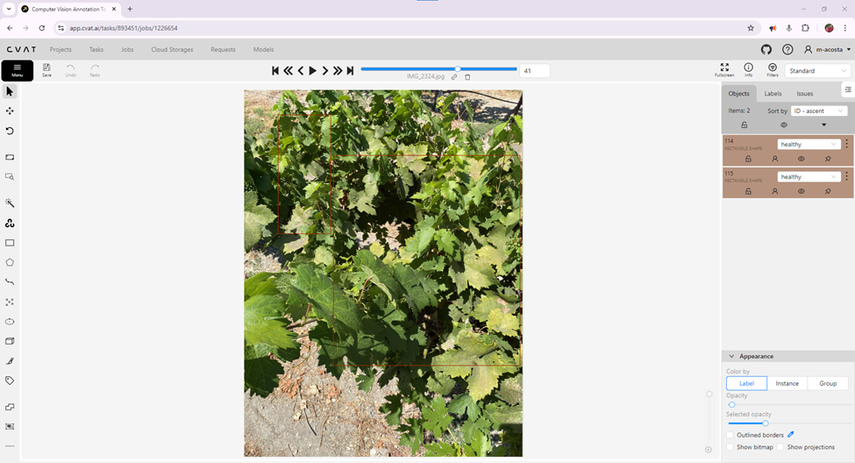
Notes:
Speaking about what Dr. Bhandari mentioned yesterday about rating the severity of the disease. I believe the step forward could be handing over this tool and the annotations to the plant science team. There are about 200 images like this per collection week. The drone instances I will mention later were close to 900 diseased patches which will all need to be done manually. Any one of us can highlight the healthy and diseased binary classification (which was completed by me and validated by Cristobal). However, in order to achieve the granularity of a 1-5 scale, this needs to be done by the plant science experts. So these are the steps forward I am proposing. What do you all think? Dr. Bhandari?

Slide 27
ML Training - Handheld Camera
There are 156 total collected images, all YOLO annotated in CVAT.
The images are split 80/10/10 for training, validation, and test.
There are 165 healthy instances and 200 diseased instances in the training and validation datasets.
Healthy plants are large sections of the plant highlighted with a bounding box, avoiding extraneous objects such as the dirt below or metal support wires.
Diseased labels will be much smaller and target areas where PM is the worst.

Slide 28
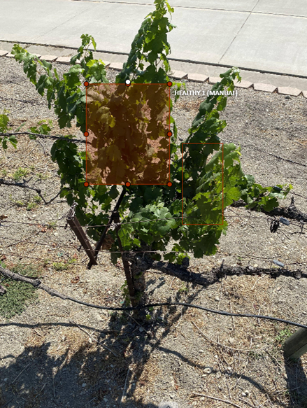
Notes:
This shows the first approach with larger bounding boxes. I aimed to capture as much vine as possible until running into dirt, metal wires, or any other obstructions. Even with an almost even class distribution, the models trained with this data became better at classifying the healthy class, which is not what we wanted.

Slide 29
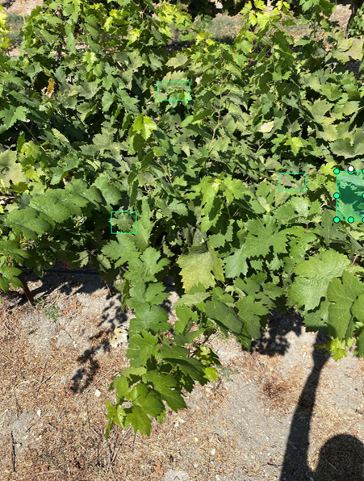
Notes:
The diseased boxes are much smaller. They target the PM and end when they start touching healthy leaves.

Slide 30
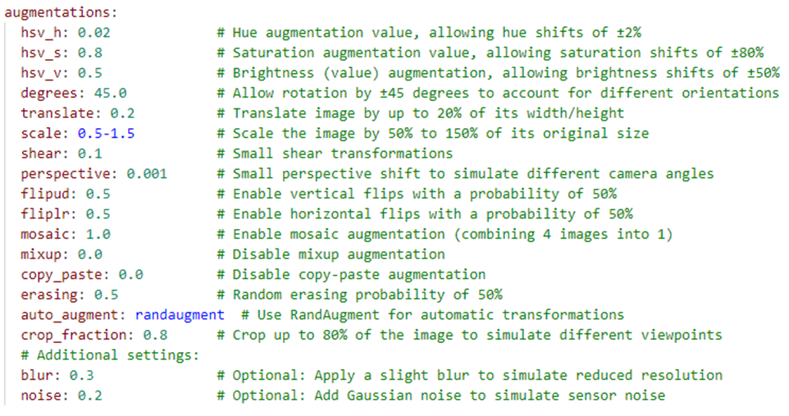
Notes:
These were the augmentations I used when training with the handheld data. The scale modifier was set with a higher range in order to help the model perform better on the drone data. The brightness, hue, and saturation values at the top are very important because the lighting conditions vary a lot between each image.

Slide 31
Any questions so far?

Slide 32
ML Training - Drone
There are 300 total collected images, all YOLO annotated in CVAT.
The images are split 80/10/10 for training, validation, and test.
There are 868 healthy instances and 868 diseased instances in the training and validation datasets.
Healthy plants are small bounding boxes (that match the diseased ones).
Diseased labels are small and target areas where PM is the worst.

Slide 33
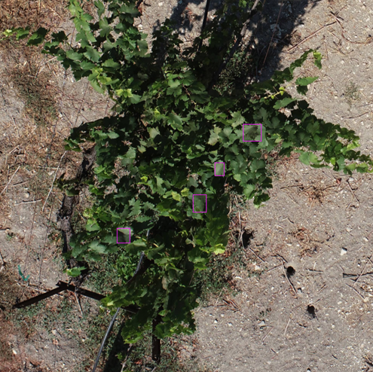
Notes:
Now the healthy boxes are around the same size as the diseased ones, about 100 by 100 pixels. This class needed to be down-sampled as there are many more healthy leaves than diseased ones.

Slide 34
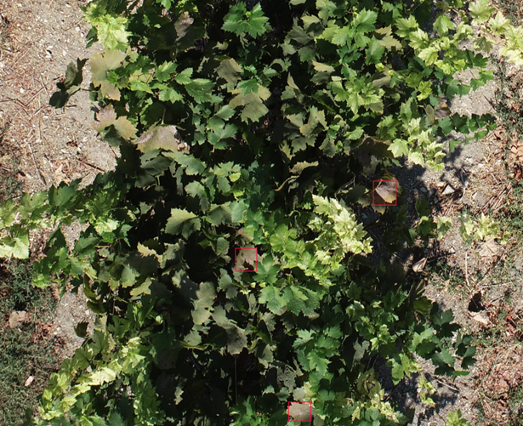
Notes:
Here is what the diseased annotations look like from the drone. It is possible still to see the PM from 5 meters and this resolution, but harder than the handheld camera. Taking the drone up to 7 meters makes this even more difficult.

Slide 35
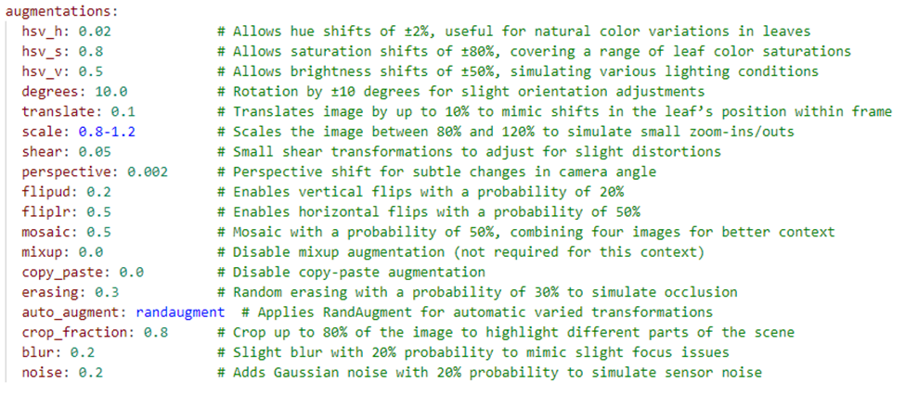
Notes:
These augmentations are more specialized for the drone data and allow it to generalize and perform better regardless of the testing data.

Slide 36
Evaluate Model Performance
Images from handheld cameras and drones are analyzed using YOLO versions, with predictions made as bounding boxes, each image likely having multiple predictions.
GPS location is extracted from EXIF data and mapped to pixels, with the center of the bounding box representing the GPS location.
Predictions are classified as healthy or diseased, with manual checks by experts to verify accuracy; mismatches are labeled false positives, while correct matches are true positives.

Slide 37
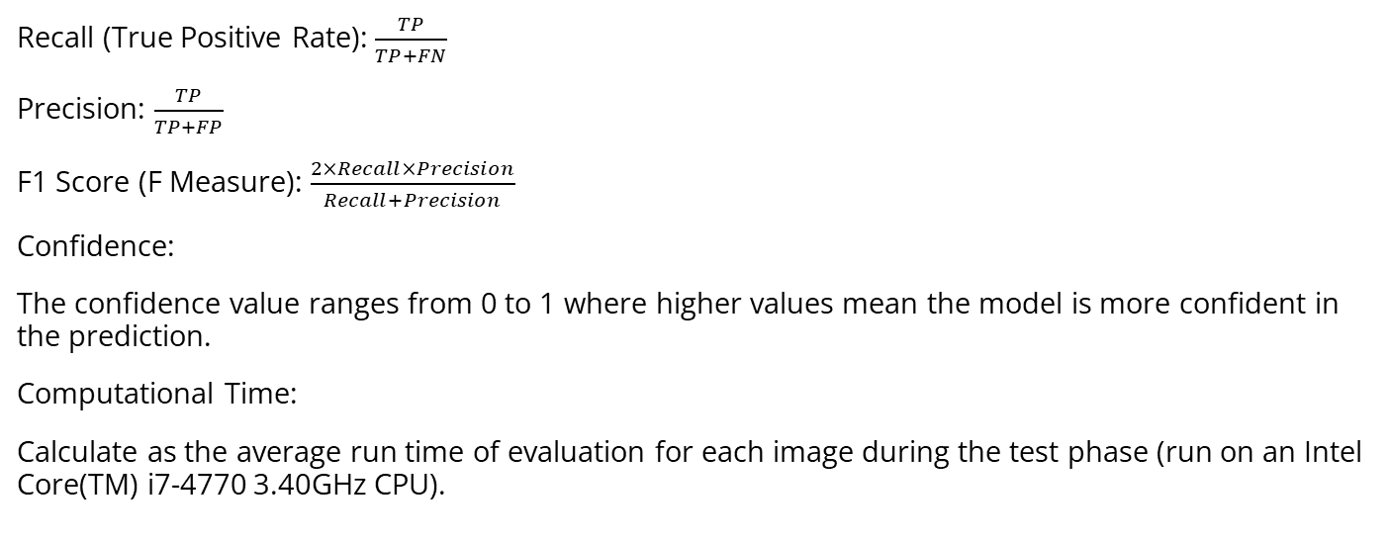
Metrics
Recall (True Positive Rate): $\frac{TP}{TP+FN}$
Precision: $\frac{TP}{TP+FP}$
F1 Score (F Measure): $\frac{2×Recall×Precision}{Recall+Precision}$
Confidence:
The confidence value ranges from 0 to 1 where higher values mean the model is more confident in the prediction.
Computational Time:
Calculate as the average run time of evaluation for each image during the test phase (run on an Intel Core(TM) i7-4770 3.40GHz CPU).

Slide 38
3. Results

Slide 39
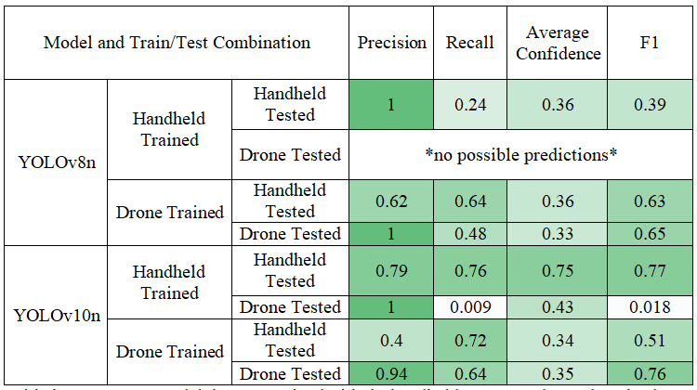
Results
Notes:
The first thing that stands out is YOLOv8, handheld training, and drone testing did not make any predictions. The model learned the handheld images and was not able to generalize on the drone images. This is where the models struggled the most: from handheld to drone. So training with drone data showed better results across the board. The best performing model is v10, handheld training, and handheld testing. Also of note, there are a lot of models that made no false positive predictions and achieved 100% percision.

Slide 40
Comparison of Models
There are 8 combinations of model architecture, training dataset, and test dataset.
The focus is solely on the diseased class. The model is not evaluated on its predictions for the healthy class.
Once the predictions are made, they are reviewed by an expert (ground truth).

Slide 41
Comparison of Models
Each image in the test set is annotated in advance in order to capture the entire area that is infected with PM.
This shows all of the positive cases of PM that are present in the vineyard.
Recall is more valuable, as identifying as much PM in the vineyard as possible is the goal. If this means more false positives, that is acceptable.

Slide 42
Comparison of Models
YOLO models performed better at detecting powdery mildew when training and test images were the same (e.g., handheld vs. handheld), with reduced success when images varied (e.g., handheld vs. drone).
The best YOLO model achieved 79% precision, 76% recall, and 77% F1 score using YOLOv10n with handheld images for both training and testing.
The model performed well with heavily diseased cases of PM but struggled with overexposed leaves and areas of dirt; factors like bounding box size and image quantity affected results, suggesting room for improvement.

Slide 43
Train/Test with Different Dataset
4 of the models are training with different images than the test set.
These performed much worse that matching image sets.
The initial approach was to explore this method.
The models just don’t generalize very well with the change in resolution.

Slide 44
Handheld Camera: Test Data
The test set is comprised of 15 images across the weeks of collection.
This is 10% of the total images from the handheld camera.
There are 25 instances of PM present within these images.

Slide 45
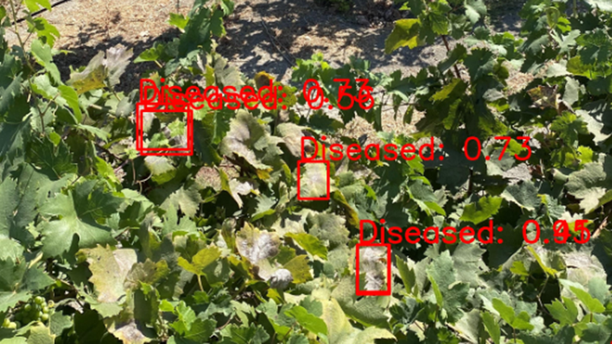
Bounding Box Collisions
Notes:
A lot of the images contain collisions with the bounding boxes. The lower confidence predictions were removed in order to avoid inflating the true positive predictions. In the future, this can be handled in a more efficient manner. My daughter looked at this image yesterday and wondered why “the sick leaves in the middle didn’t have a red box around them”. So that speaks to the amount of missed detections (false negatives). And how much we can see with just our eyes.

Slide 46
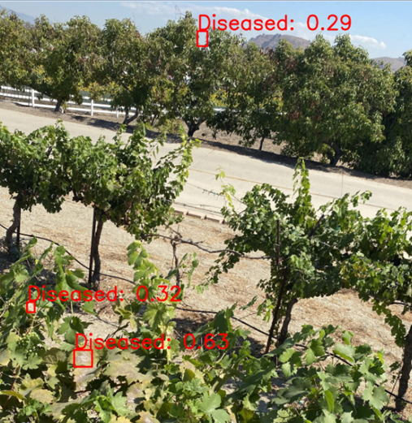
Distant False Positives
Notes:
A lot of false positive occurred when there is a circle of leaves and the center is a patch of dirt that resembles the coloring of PM. However, as shown, there is even a patch of sky that was labelled as diseased. A potential fix here is making the bounding box annotations larger so they have more context. That way the models can learn the vines from the miscellaneous objects. These predictions also happen because of the capture angle of the camera. The model is trained on drone images overhead. When it is tested on handheld images that show objects that are much farther away, it results in some of these false positives.

Slide 47
Drone: Test Data
The test set is comprised of 30 images across the weeks of collection.
This is 10% of the total images from the handheld camera.
There are 109 instances of PM present within these images.

Slide 48
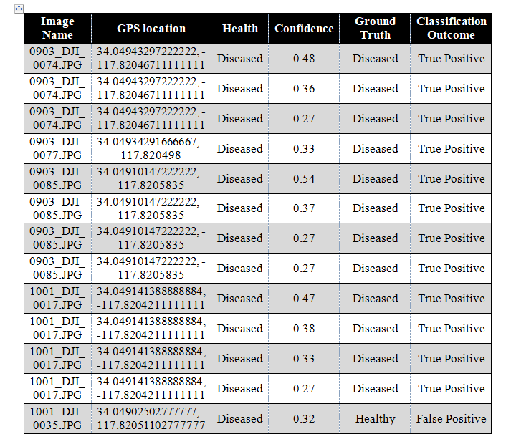
Notes:
This table shows the beginning of one of the output tables from the prediction algorithm. The GPS location is found with the center of the bounding box. The ground truth comes from the plant science team lead by Cristobal. The classification is either a true positive or false positive based on whether the two values match. The ratio between the two becomes the precision. This comes from the YOLOv10 model that was trained and tested with drone data.

Slide 49
Confidence
The low confidence values could come from a lack of diversity in the dataset or size.
Another issue could be the small size of PM compared to the resolution.
It needs to be explored in the future why the precision is so high, but the confidence values are not.
None of the predictions were excluded based on confidence because recall was the priority.

Slide 50
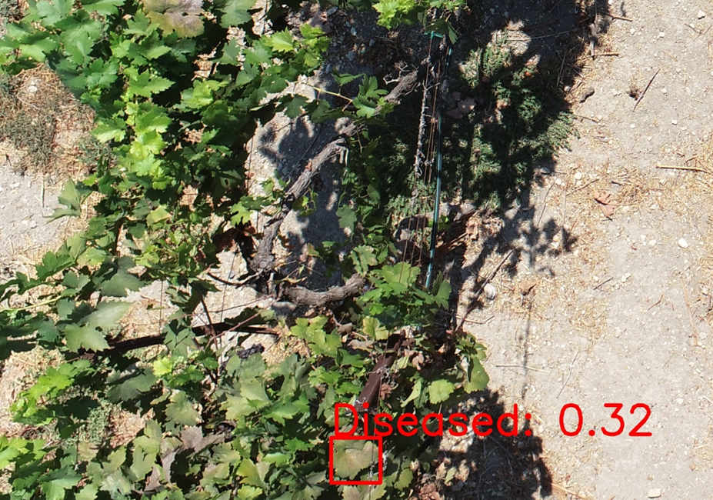
True Positive Prediction

Slide 51
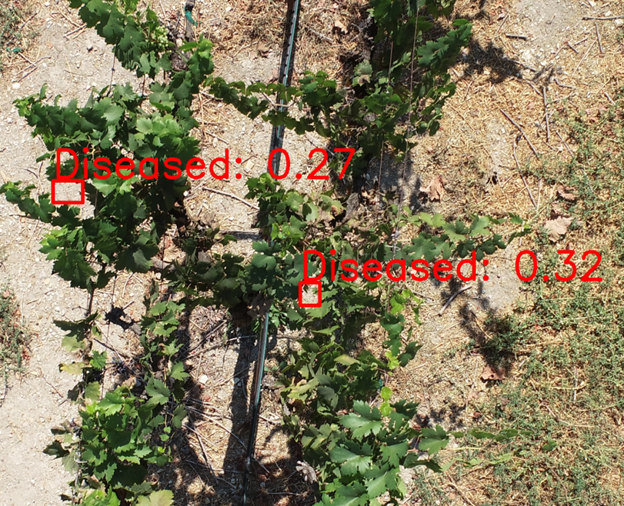
False Positive Prediction

Slide 52
Comparison
Drone-trained models have lower prediction confidence, but still perform well, while handheld camera-trained models sometimes fail to make predictions due to fewer PM instances in the dataset.
Precision generally outperforms recall, indicating high-quality predictions with fewer false positives, but the system aims to prioritize recall to detect more PM.
Drone-based training is more promising than handheld cameras, as it provides faster, reproducible, and more easily automated image collection, enhancing the effectiveness of ML in precision agriculture.
The drone training also scored high with F1 across the board when compared to handheld training.

Slide 53
4. Conclusion

Slide 54
Discussion
Images collected later in the growth cycle are more valuable as PM becomes more apparent. Early-stage detection is harder, especially with images taken from above.
PM thrives on the underside of vines, and an AR app with a YOLO model could help identify diseased leaves using a phone camera.

Slide 55
Discussion
False positives, such as dirt resembling PM, are an issue; increasing bounding box size could reduce this problem.
The number of training epochs affects performance, and the ideal value needs further exploration to avoid overfitting/underfitting.
The study used YOLO nano architecture for real-time processing, trading off precision and recall for lightweight size and speed suitable for drones. Much higher scores could be achieved with the performance models.

Slide 56
Conclusion
AI and ML provide cost-effective solutions for detecting PM in vineyards using lightweight YOLO models with handheld cameras and drones.
YOLOv10n, trained on handheld images, achieved 79% precision, 76% recall, and 77% F1 score; drone models showed strong large-scale monitoring potential.
Challenges include false positives (due to dirt) and variability in image quality, with potential improvements from better image diversity and collection angles.
Drone-based data collection offers superior scalability, making it ideal for precision agriculture and crop health management.
Notes:
My recommendation going forward is to use drone images to train. The results were better across the board and reproducible.

Slide 57
Future Work
The ultimate goal of this work at Cal Poly Pomona is to have drones and UGVs working maintain a field of crops.
This is useful for weed removal, pesticide application, etc.
The drone will fly and identify the areas that contain weeds or pests and communicate that information to the UGV. The UGV will then go in with that general location and use its targeted sensors to correct the problem.
There will be a trained YOLO model on a drone equipped with an NVIDIA Jetson processor to detect in real time.
Also, work with hyperspectral imagery will also continue within this project.

Slide 58
Acknowledgements
The project was supported by the ARI Grant Number 23-04-113.

Slide 59
References
[1] Knauer, Uwe, et al. “Improved Classification Accuracy of Powdery Mildew Infection Levels of Wine Grapes by Spatial-Spectral Analysis of Hyperspectral Images.” Plant Methods, vol. 13, no. 1, 2017, https://doi.org/10.1186/s13007-017-0198-y. Accessed 14 Apr. 2023.
[2] Bayoumi, Tarek Y., and A. A. Abdullah. “Application of thermal imaging sensor to early detect powdery mildew disease in wheat.” The Journal of Middle East and North Africa Sciences, vol. 2, no. 2, 2016, pp. 56–63, https://doi.org/10.12816/0032657.
[3] Khan, Imran Haider, et al. “Early detection of powdery mildew disease and accurate quantification of its severity using hyperspectral images in wheat.” Remote Sensing, vol. 13, no. 18, 2021, p. 3612, https://doi.org/10.3390/rs13183612.
[4] Kunova, Andrea, et al. “Grapevine powdery mildew: Fungicides for its management and advances in molecular detection of markers associated with resistance.” Microorganisms, vol. 9, no. 7, 20 July 2021, p. 1541, https://doi.org/10.3390/microorganisms9071541.
[5] Khan, Imran Haider, et al. “Early detection of powdery mildew disease and accurate quantification of its severity using hyperspectral images in wheat.” Remote Sensing, vol. 13, no. 18, 2021, p. 3612, https://doi.org/10.3390/rs13183612.

Slide 60
References
[6] Neupane, Krishna, and Fulya Baysal-Gurel. “Automatic identification and monitoring of plant diseases using unmanned aerial vehicles: A Review.” Remote Sensing, vol. 13, no. 19, 2021, p. 3841, https://doi.org/10.3390/rs13193841.
[7] Strange, Richard N., and Peter R. Scott. “Plant disease: A threat to Global Food Security.” Annual Review of Phytopathology, vol. 43, no. 1, 1 Sept. 2005, pp. 83–116, https://doi.org/10.1146/annurev.phyto.43.113004.133839.
[8] Yang, Yang, et al. “Nitrogen concentration and dry-matter accumulation in maize crop: Assessing maize nitrogen status with an allometric function and a chlorophyll meter.” Communications in Soil Science and Plant Analysis, vol. 43, no. 11, 2012, pp. 1563–1575, https://doi.org/10.1080/00103624.2012.675393.
[9] Demir, Ilke, et al. “DeepGlobe 2018: A Challenge to parse the Earth through satellite images.” 2018 IEEE/CVF Conference on Computer Vision and Pattern Recognition Workshops (CVPRW), June 2018, https://doi.org/10.1109/cvprw.2018.00031.

Slide 61
References
[10] Balaji, Shree Ram, et al. “Cybersecurity challenges and solutions in IOT-based Precision Farming Systems.” 2023 IEEE 14th Annual Ubiquitous Computing, Electronics &amp; Mobile Communication Conference (UEMCON), 12 Oct. 2023, pp. 237–246, https://doi.org/10.1109/uemcon59035.2023.10316154.

Slide 62
Q & A

